Slide 1

S And S Marketing
Smile with Simply steps
Smart and Simply Marketing
A simple way to life

Slide 2
A Unique and Simple Plan
2 WAYS TO GET MEMBERSHIP
1. By Paying
You Can Get Membership
By Paying ₹1100
2. By purchasing our products
You can get membership
by purchasing your loved product from us.
S And S Marketing
GST No:- 29CBSPP3783L1ZJ
PAN NO:- CBSPP3783L

Slide 3
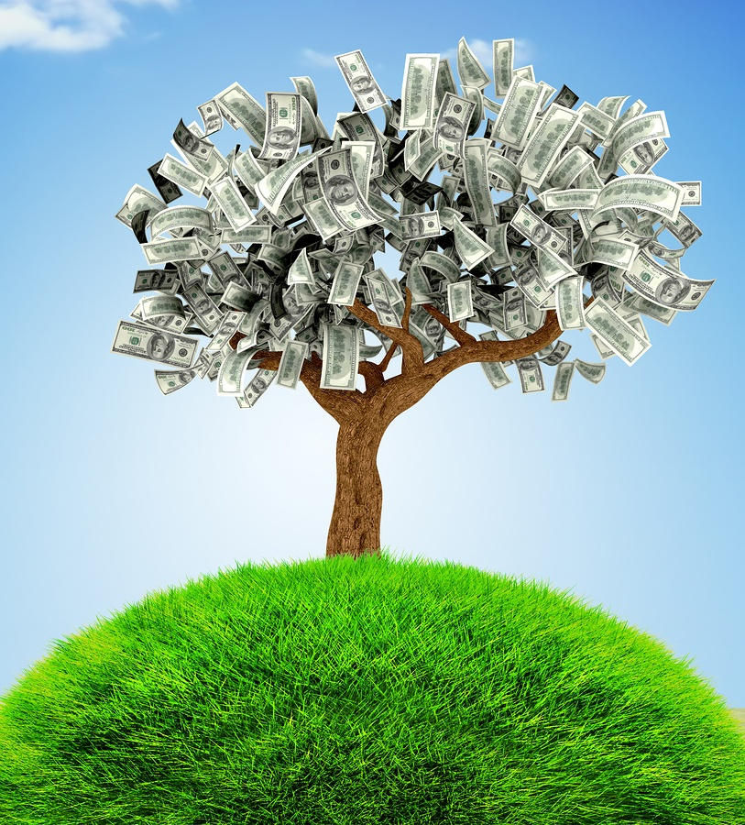
BENEFITS
Get your loved product
Life time membership
Work as an agent
5 types of income
Get 5% offer on products
Buy through EMI with 0% interest
* (customer commission amount will be consider as emi for ordered product)
One person can get more ID's
One time payment only
No down payment
S And S Marketing
GST No:- 29CBSPP3783L1ZJ
PAN NO:- CBSPP3783L

Slide 4
OFFERS
EMI option
Buy products with EMI option And this offer valid for the product price above 10000
5% Off on all products
Buy Products And Get 5% Off On All Products
This Offer Valid For One Time Payment And Buying Option
S And S Marketing
GST No:- 29CBSPP3783L1ZJ
PAN NO:- CBSPP3783L

Slide 5

Income -1
Introduce only 3 customers
Get ₹1200
Deducted tax and amount can transfer to your bank account
S And S Marketing
GST No:- 29CBSPP3783L1ZJ
PAN NO:- CBSPP3783L

Slide 6

INCOME -2
Introduce The Members
3:3:3 ₹ 450
9:9:9 ₹ 1,350
27:27:27 ₹ 4,050
81:81:81 ₹ 12,150
243:243:243 ₹ 36,450
729:729:729 ₹ 1,00,000
Deducted tax and amount can transfer to your bank account
S And S Marketing
GST No:- 29CBSPP3783L1ZJ
PAN NO:- CBSPP3783L

Slide 7
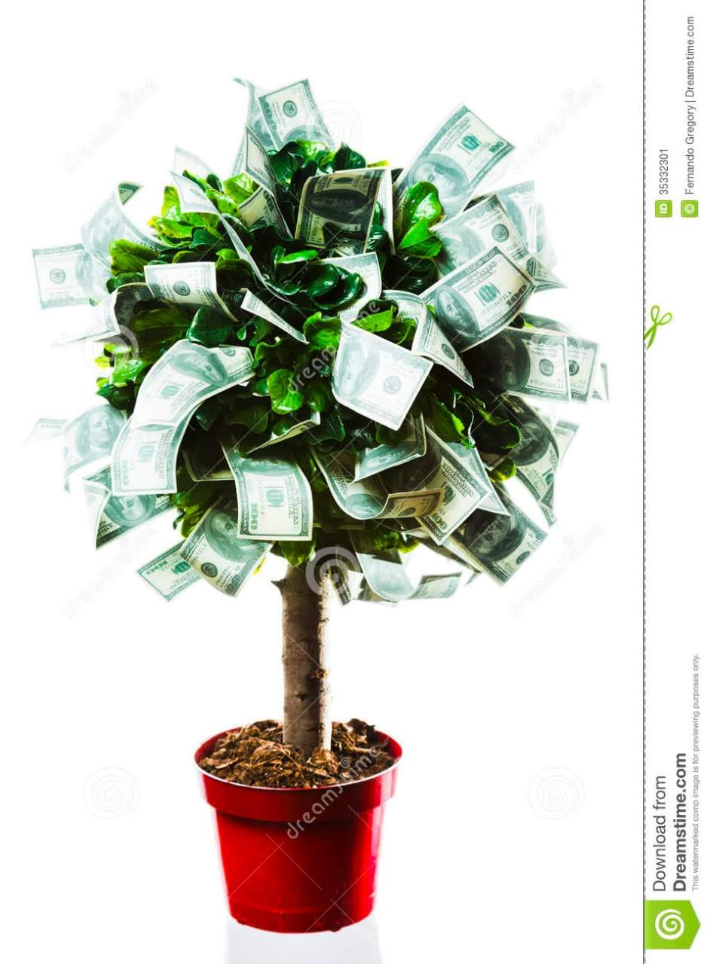
INCOME -3
Direct Introduce
1 customer - ₹ 400
10 customer - ₹ 4,000
20 customer - ₹ 8,000
50 customer - ₹ 20,000
Unlimited...!!
Deducted tax and amount can transfer to your bank account
S And S Marketing
GST No:- 29CBSPP3783L1ZJ
PAN NO:- CBSPP3783L

Slide 8
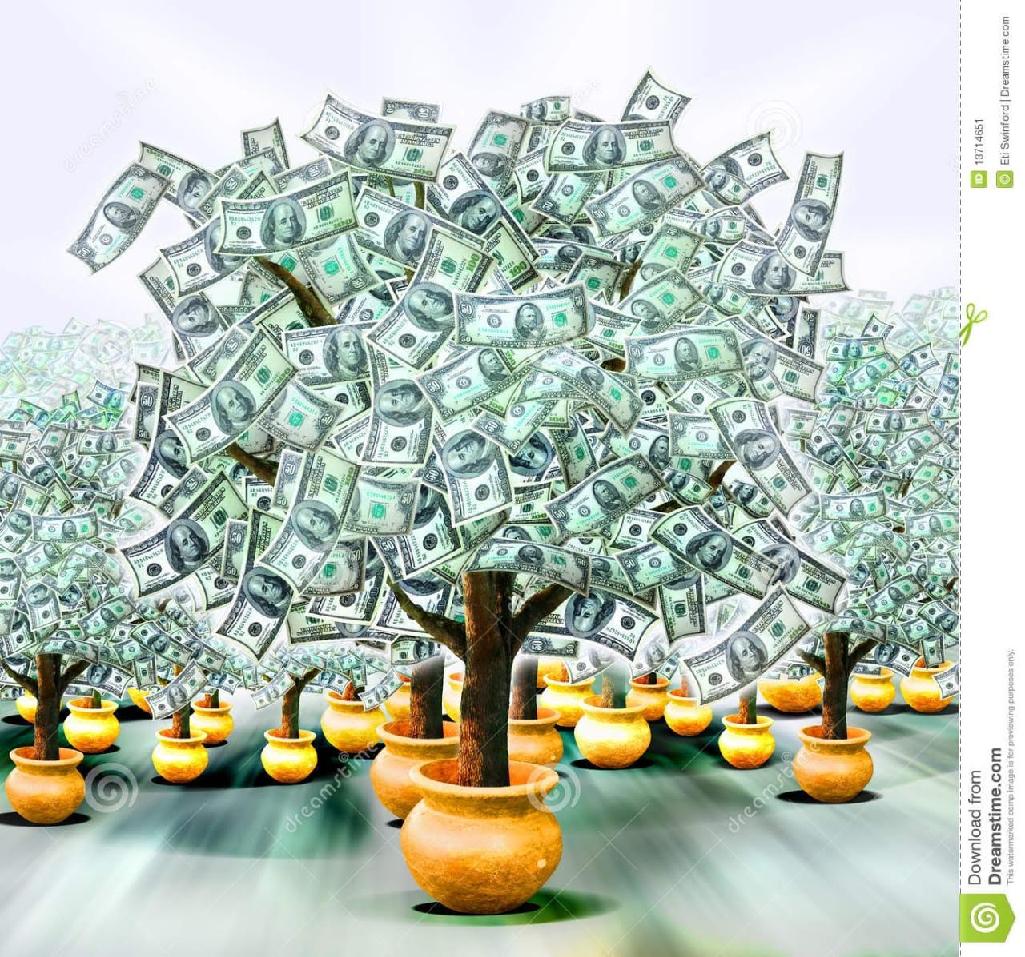
INCOME - 4
Earn More Together
Earn ₹3300 per day
Earn ₹23100 per week
Earn ₹99000 per month
Deducted tax and amount can transfer to your bank account
S And S Marketing
GST No:- 29CBSPP3783L1ZJ
PAN NO:- CBSPP3783L

Slide 9
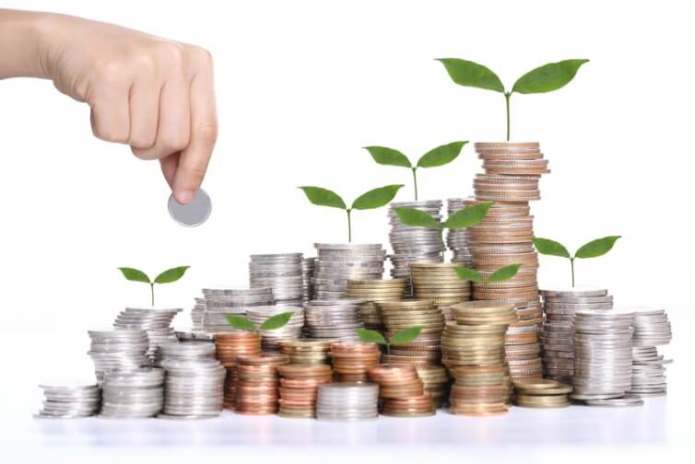
INCOME - 5
Extra gift vouchers
25:25:25 ₹2500
50:50:50 ₹5000
100:100:100 ₹10000
250:250:250 ₹15000
500:500:500. ₹25000
Deducted tax and amount can transfer to your bank account
S And S Marketing
GST No:- 29CBSPP3783L1ZJ
PAN NO:- CBSPP3783L

Slide 10
Buy products without extra money
Don't pay any extra amount.
Buy products through your commission amount.
S And S Marketing
GST No:- 29CBSPP3783L1ZJ
PAN NO:- CBSPP3783L

Slide 11
¤§AzsÀ£ÉUÀ¼ÀÄ:
£ÀªÀÄä°ègÀÄªÀ ¥ÀzÁxÀðUÀ¼À£ÀÄß ªÀiÁgÁl ªÀiÁqÀÄªÀÅzÀÄ EzÀgÀ ªÀÄÄRå GzÉÝÃ±ÀªÁVzÉ.
AiÀiÁªÀÅzÉÃ M§â ªÀåQÛUÀÆ ¸ÀA¸ÉÜUÉ ¸ÉÃgÀ¨ÉÃPÉA§ ¤§ðAzsÀªÁUÀ°Ã, MvÀÛqÀªÁUÀ°Ã EgÀÄªÀÅ¢®è. ¸Àé EZÉÒ¬ÄAzÀ AiÀiÁgÀÄ ¨ÉÃPÁzÀgÀÆ ¸ÀzÀ¸ÀåvÀéªÀ£ÀÄß ºÉÆAzÀ§ºÀÄzÀÄ.
M§â ªÀåQÛAiÀÄÄ MAzÀQÌAvÀ ºÉZÀÄÑ LrUÀ¼À£ÀÄß ºÉÆAzÀ§ºÀÄzÀÄ.
F CfðAiÀÄ eÉÆvÉUÉ ¥Á¸ï¥ÉÆÃmïð¸Éêeï ¥sÉÆÃmÉÆÃ, DzsÁgïPÁqïð, ¥Áå£ïPÁqïð ºÁUÀÆ ¨ÁåAPï ¥Á¸ï§ÄPï£À eÉgÁPïì ¥ÀæwUÀ¼À£ÀÄß ®UÀwÛ¸À¨ÉÃPÀÄ.
F ¸ÀA¸ÉÜAiÀÄ ¥ÀæwAiÉÆ§â ¸ÀzÀ¸Àå£ÀÄ ¸ÀA¸ÉÜAiÀÄ KeÉAmï DV PÁAiÀÄð¤ªÀð»¸ÀÄªÀ CªÀPÁ±À«gÀÄvÀÛzÉ EAvÀºÀ KeÉAmïUÀ¼ÀÄ ¸ÀA¸ÉÜUÉ ¥ÀjZÀ¬Ä¸ÀÄªÀ UÁæºÀPÀgÀÄ CxÀªÁ ¸ÀzÀ¸ÀågÀ ¥ÀgÀªÁV PÀ«ÄµÀ£ï ¥ÀqÉAiÀÄ®Ä CºÀðgÁVgÀÄvÁÛgÉ.
vÀªÀÄUÉ zÉÆgÉvÀ PÀ«ÄµÀ£ï gÀÆ¥ÀzÀ ºÀtzÀ°è ¸ÀzÀ¸ÀågÀÄ vÀªÀÄUÉ ¨ÉÃPÁzÀ £ÀªÀÄä°è ®¨sÀå«gÀÄªÀ AiÀiÁªÀÅzÉÃ ªÀ¸ÀÄÛUÀ¼À£ÀÄß PÉÆAqÀÄPÉÆ¼Àî§ºÀÄzÀÄ. ªÀ¸ÀÄÛUÀ¼À£ÀÄß PÉÆAqÀÄPÉÆ¼Àî®Ä EµÀÖ«®è¢zÀÝ°è ºÀtªÀ£ÀÄß vÀªÀÄä ¨ÁåAPï SÁvÉUÉ ªÀUÁð¬Ä¹PÉÆ¼Àî§ºÀÄzÀÄ.
UÁæºÀPÀjUÉ PÀAw£À ªÀÄÆ®PÀ ªÀ¸ÀÄÛUÀ¼ÀÄ CUÀvÀå«zÀÝ°è CAvÀºÀ UÁæºÀPÀgÀÄ £À«ÄäAzÀ 5,000/- gÀÆgÀµÀÄÖ PÀ«ÄµÀ£ï ¥ÀqÉzÀ £ÀAvÀgÀªÀµÉÖÃ PÀAw£À ªÀÄÆ®PÀ ªÀ¸ÀÄÛUÀ¼ÀÄ ®¨sÀå«gÀÄvÀÛªÉ.
£ÀªÀÄä°ègÀÄªÀ ªÀ¸ÀÄÛUÀ¼ÀÄ ªÀiÁgÁlªÁzÀ DzÁAiÀÄzÀ ªÀÄÆ®¢AzÀ ªÀiÁvÀæ PÀ«ÄµÀ£ï ¤ÃqÀ¯ÁUÀÄªÀÅzÀÄ.
¸ÀzÀ¸ÀågÉ®ègÀÆ £ÀªÀÄä°ègÀÄªÀ ªÀ¸ÀÄÛUÀ¼À£ÀÄß RjÃ¢¸À¯ÉÃ¨ÉÃPÉA§ PÀqÁØAiÀÄzÀ ¤AiÀÄªÀÄ«®è¢zÀÝgÀÆ ¸ÀA¸ÉÜAiÀÄ PÉ®ªÉÇAzÀÄ ¤AiÀÄªÀÄUÀ½UÉ §zÀÞgÁVgÀ¨ÉÃPÀÄ.
F ¸ÀA¸ÉÜAiÀÄÄ ¸ÀzÀ¸ÀåjAzÀ AiÀiÁªÀÅzÉÃ ¸ÀÄgÀPÀëvÁ PÀgÁgÀÄUÀ¼À£ÀÄß (£ÀµÀÖ ¥ÀjºÁgÀ ¸ÀÄgÀPÀëvÁ PÀgÁgÀÄ ¥ÀvÀæ) ¥ÀqÉAiÀÄzÉÃ ªÀ¸ÀÄÛUÀ¼À£ÀÄß PÀAvÀÄUÀ¼À°è ¤ÃqÀÄwÛgÀÄªÀ PÁgÀt £ÁªÀÅ ¥ÀæwAiÉÆ§âgÀ ¸ÀzÀ¸ÀåvÀéPÀÆÌ ªÀÄÄAUÀqÀ ºÀt 1,100/- gÀÆUÀ¼À£ÀÄß ¥ÀqÉ¢gÀÄvÉÛÃªÉ.
¸ÀzÀ¸ÀåvÀé ¥ÀqÉzÀÄPÉÆAqÀ ªÀåQÛ ªÀÄvÉÛ ªÀÄÆgÀÄ d£ÀgÀ£ÀÄß ¸ÀzÀ¸ÀåvÀéPÉÌ £ÉÆAzÁ¬Ä¹ vÁªÀÅ ªÉÆzÀ®Ä ¤ÃrzÀ ªÀÄÄAUÀqÀ ºÀtªÀ£ÀÄß »A¥ÀqÉAiÀÄ§ºÀÄzÀÄ. MAzÀÄ ªÉÃ¼É AiÀiÁªÀÅzÉÃ ¸ÀzÀ¸ÀågÀ£ÀÄß ¸ÀzÀ¸ÀåvÀéPÉÌ £ÉÆAzÁ¬Ä¸ÀzÉÃ EzÀÝ°è CzÀgÀ §zÀ¯ÁV D ªÀÄÄAUÀqÀ ºÀtzÀ eÉÆvÉUÉ PÀ¤µÀÖ 4000/-gÀÆ ªÀiË®åzÀ ªÀ¸ÀÄÛUÀ¼À£ÀÄß ªÀÄÄAUÀqÀ ºÀtzÀ dªÀiÁzÉÆA¢UÉ ªÀ¸ÀÄÛUÀ¼À£ÀÄß RjÃ¢¸ÀÄªÀ ªÀÄÆ®PÀ »A¥ÀqÉAiÀÄ§ºÀÄzÀÄ.
¥ÀÆwð ºÀt ¥ÁªÀw¹ £ÀªÀÄä°ègÀÄªÀ ªÀ¸ÀÄÛUÀ¼À£ÀÄß RjÃ¢¸ÀÄªÀ UÁæºÀPÀjUÉ ±ÉÃ 5 gÀµÀÄÖ jAiÀiÁ¬Äw zÉÆgÉAiÀÄÄvÀÛzÉ.
¸ÀA¸ÉÜAiÀÄ°è UÁæºÀPÀgÀ£ÀÄß ºÉaÑ¸ÀÄªÀ zÀÈ¶Ö¬ÄAzÀ ªÀiÁvÀæ PÀ«ÄµÀ£ï ¤ÃqÀ¯ÁUÀÄwÛzÀÄÝ EzÀgÀ ªÀÄÄRå GzÉÝÃ±À £ÀªÀÄä°ègÀÄªÀ ªÀ¸ÀÄÛUÀ¼À£ÀÄß ªÀiÁgÁl ªÀiÁqÀÄªÀÅzÁVzÉAiÉÄÃ ºÉÆgÀvÀÄ ¨ÉÃgÉ AiÀiÁªÀÅzÉÃ GzÉÝÃ±À«gÀÄªÀÅ¢®è.
¸ÀzÀ¸ÀåvÀéªÀ£ÀÄß ªÀÄÄAzÀÄªÀgÉ¸À®Ä EµÀÖ«®è¢zÀÝ°è ¸ÀA¸ÉÜAiÀÄ UÀªÀÄ£ÀPÉÌ vÀAzÀÄ gÀzÀÄÝ¥Àr¹PÉÆ¼Àî§ºÀÄzÀÄ. (¸ÀÆZÀ£É: gÀzÀÄÝUÉÆ½¹PÉÆ¼Àî¨ÉÃPÁzÀAvÀºÀ ¸ÀzÀ¸ÀågÀÄ ¸ÀA¸ÉÜUÉ ¸ÉÃj PÀ¤µÀÖ 6 wAUÀ¼ÁVgÀ¨ÉÃPÀÄ)
£ÀªÀÄä ¸ÀA¸ÉÜAiÀÄ PÀqÉ¬ÄAzÀ AiÀiÁªÀÅzÉÃ jÃwAiÀÄ vÉÆAzÀgÉUÀ¼ÀÄ PÀAqÀÄ§AzÀ°è ¸ÀA¸ÉÜAiÀÄ UÀªÀÄ£ÀPÉÌ vÀAzÀgÉ §UÉºÀj¹PÉÆqÀ¯ÁUÀÄvÀÛzÉ.
UÁæºÀPÀjUÉ ªÀ¸ÀÄÛUÀ¼À£ÀÄß ¥ÁægÀA¨sÀzÀ PÀAvÀÄ 5,000/- gÀÆUÀ½AzÀ ¥ÁægÀA¨sÀªÁVzÀÄÝ, £ÀAvÀgÀzÀ PÀAvÀÄUÀ¼ÀÄ ¥ÀæwÃ 5,000/-PÉÌ ºÉZÀÄÑvÀÛzÉ.
UÁæºÀPÀjUÉ PÀAw£À ªÀÄÆ®PÀ ªÀ¸ÀÄÛUÀ¼ÀÄ ¨ÉÃQzÀÝ°è CAvÀºÀ UÁæºÀPÀjUÉ AiÀiÁªÀÅzÉÃ ºÀtªÀ£ÀÄß ¥ÀqÉAiÀÄÄªÀAw®è §zÀ°UÉ PÀ«ÄµÀ£ï ªÀÄÆ®PÀ ªÀiÁvÀæªÀµÉÖÃ dªÀiÁ ªÀiÁrPÉÆ¼Àî¨ÉÃPÀÄ.
¸ÀA¸ÉÜAiÀÄ ¤AiÀÄªÀÄUÀ½UÉ ¸ÀzÀ¸ÀågÀÄ §zÀÞgÁVgÀ¨ÉÃPÀÄ ªÀÄvÀÄÛ ¸ÀA¸ÉÜAiÀÄ wÃªÀiÁð£ÀªÉÃ CAwªÀÄ wÃªÀiÁð£À.
F ªÉÄÃ°£À J¯Áè ¤AiÀÄªÀÄ ºÁUÀÆ ¤§AzsÀ£ÉUÀ½UÉ M¦à ¸À» ªÀiÁr ¸ÀzÀ¸ÀåvÀé ¥ÀqÉ¢gÀÄvÉÛÃ£É.

